Slide 1
CREDO Quick Start Manual
https://credo.education

Slide 2
The Clinical Rotation Evaluation and Documentation Organizer (CREDO) is a fast, easy to use system to gather your patient encounters and use your entries to provide real time information and relevant review materials; all while documenting your growing clinical portfolio.

Slide 3
CREDO automatically and interactively enhances your learning experience by….
providing real time information on your fulfillment of Procedure Logs
establishing a setting for interactive learning with your preceptor
improving your, your preceptor, and clinical chair’s productivity via electronic review and signatures
providing a Primer for each of your rotations
providing review facts, board level questions relevant to your patient encounters

Slide 4
Each time you log in
You will be greeted on the Welcome page where you can navigate to all parts of CREDO

Slide 5
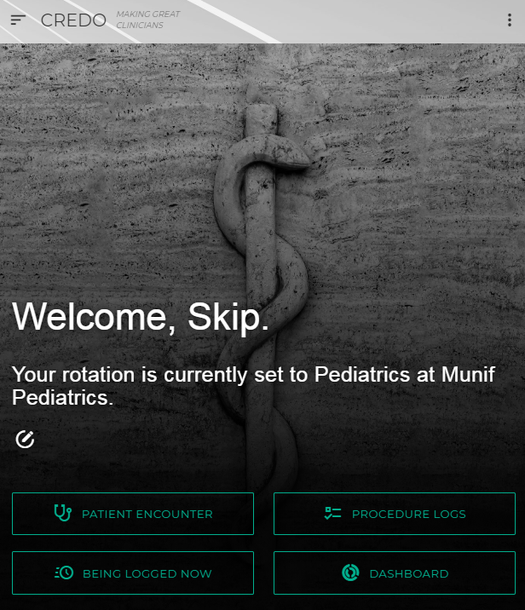
Navigate everywhere from the Welcome page
Change your Account Settings, including Rotation and Site
Get help, review instructions
Confirm your Rotation and Site in the greeting; tap/click the pencil icon to change
Enter new Patient Encounters
Access your Procedure Logs
See why your peers are doing now
Review and edit your Patient Encounters

Slide 6
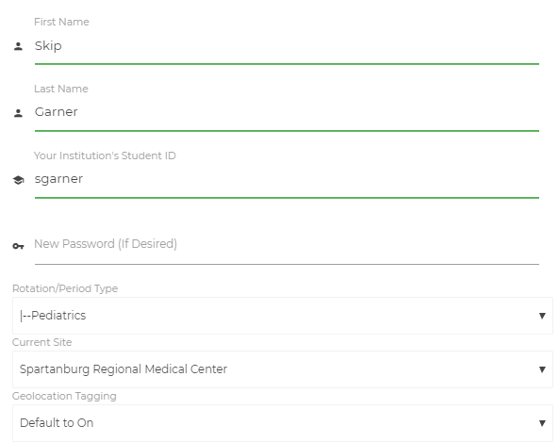
Your clinical rotation and site should be updated each period
After each clinical period, please update your Rotation/Period Type and Location
If the Location is not there, please let us know and we will immediately create one.

Slide 7
Record each patient encounter
You are led through entering diagnoses, procedures and drugs for each patient

Slide 8
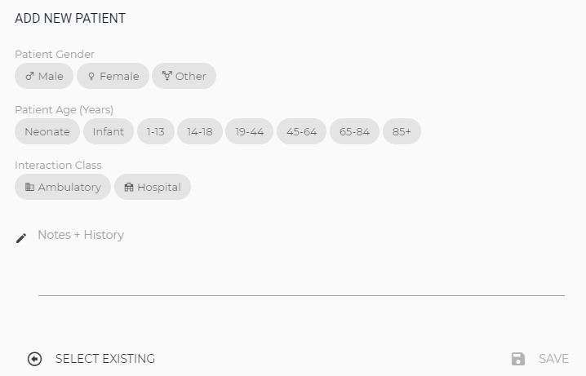
For each Patient Encounter, patient demographics are entered once…
Please enter Notes and History information, as well as hints so that you can recall this patient when discussing with your preceptor.
No PII please
See a list of previous patients, you can add more diagnoses or procedures

Slide 9
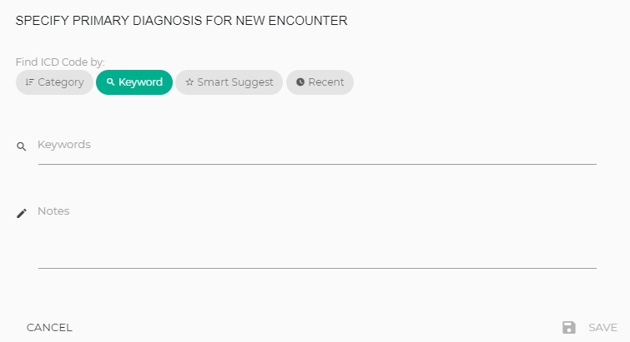
…then the Primary Diagnoses is entered…
Easily search for diagnoses, procedures and drugs
Quickly review and select from among the most frequent diagnoses seen in each rotation

Slide 10
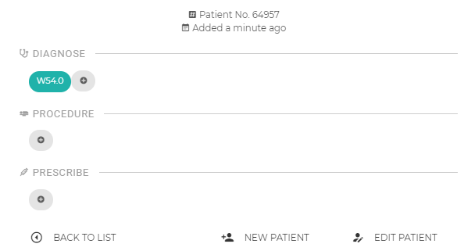
…then Procedures, additional Diagnoses and Drugs are entered…
For each Patient Encounter you can quickly enter new or review and edit all diagnoses, procedures and drugs
Click to add

Slide 11
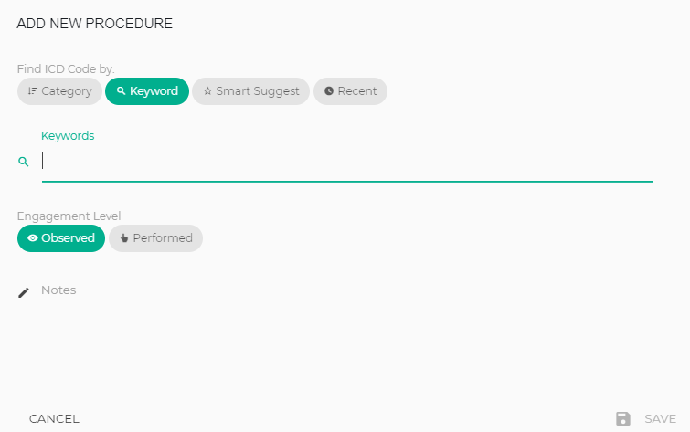
Procedures or Drugs are coupled to Diagnosis entries to show your response to a patient’s diagnosis…
The most frequent procedures for each diagnoses can suggest quick entries
Use Notes to capture precise data, such as drug dose

Slide 12
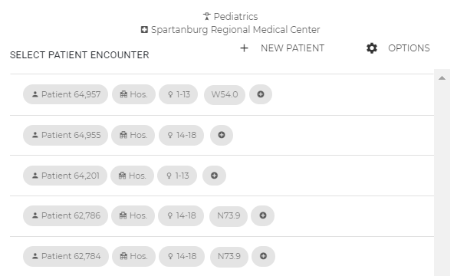
Once you have completed entering all Diagnoses, Procedures, and Drugs for a patient, you can view and edit information from your recent Patient Encounters… or start on a New Patient
Mouse over to quickly see details

Slide 13
After making entries using the Patient Encounter page… …you can review and edit your entries anytime using the Dashboard page

Slide 14
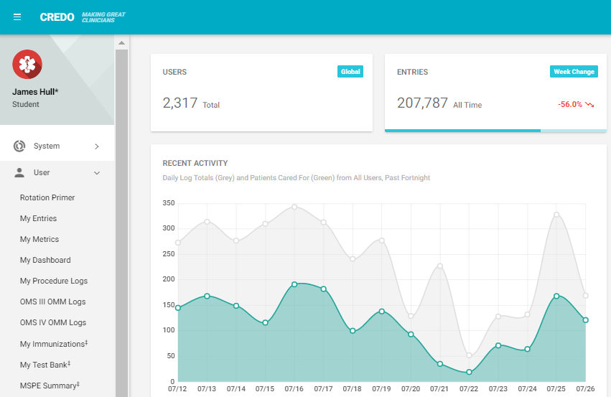
Click on the Menu on the left to access your user information
Information to prepare you for each Rotation
Edit/review Entries
Review your Rotation Statistics
Review automated fulfillment of Procedure Logs
Review OMM Logs
Secure link to your school health records
….and more is coming.

Slide 15
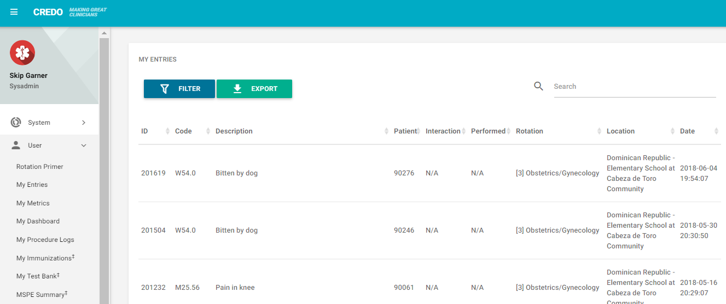
Click on an entry to edit it
Filter for certain types of entries, and export them to use how you wish
Click here to edit this entry
Search for a specific entry

Slide 16
Help is always available
Instructions and Quick Start Users Guide through the App
Submit a Support request through the App, using menu in upper-right
The primary support person is: Araba Wubah, arabawubah@gmail.com, (540) 449-5503
Or for the following:
Clinical Issues: Fred Rawlins, frawlins@vcom.edu, (540) 520-5475
Systems/Coding Issues: Skip Garner, skipgarner@gmail.com, (214) 924-8364
Technical/Account Issues: Cameron Sumpter, cs@cameronsumpter.com, (540) 692-9267

Slide 17
Happy Logging
and Thank You

